Slide 1
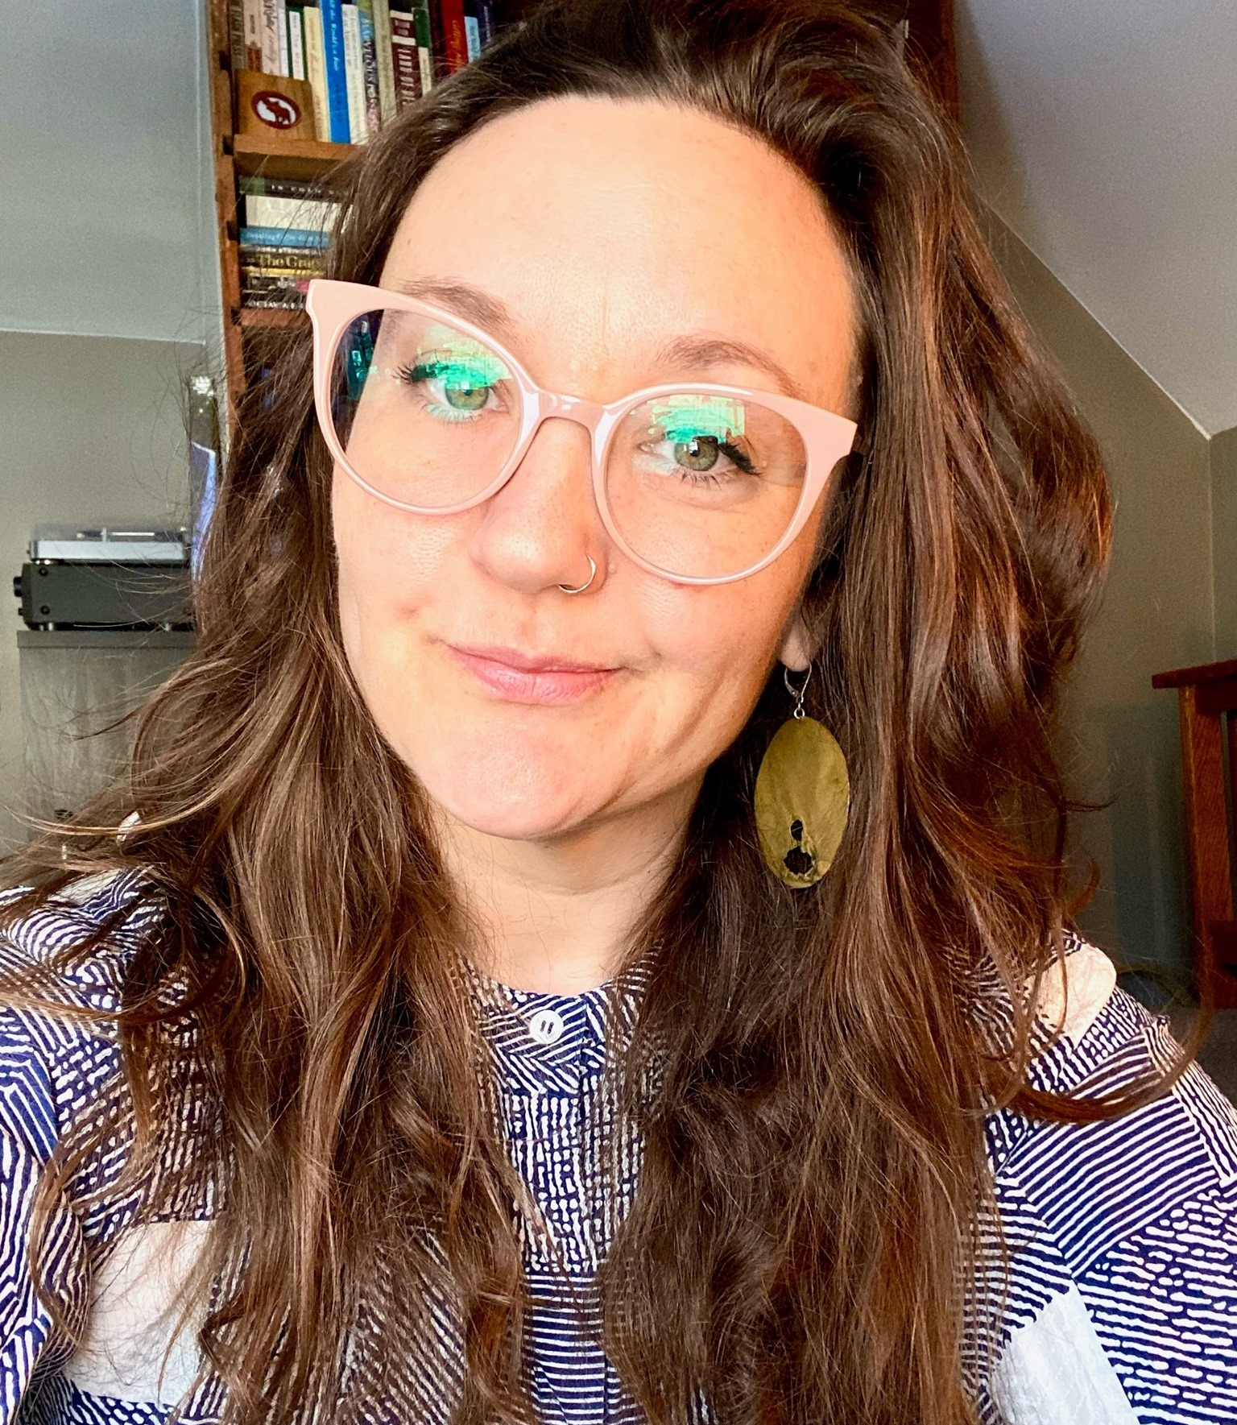
Early Attempts at Creating Accessible Classroom Technology Standards
IT ACCESS: Educause
April 6, 2022
Michelle Morgan, PhD
Digital Accessibility Specialist
Yale University
accessibility@yale.edu
michelle.morgan@yale.edu

Slide 2
Guiding Questions
What kind of guidance can we provide for making classrooms accessible more generally, not necessarily in response to specific accommodations?
Can we build this guidance into Yale standards for new builds and renovations?
Can we support that guidance once provided/implemented?

Slide 3
Gaps
Requirements for Assistive Listening Systems , e.g., are stated but the reality on the ground regarding acoustics and other considerations (esp. during virtual events or classes) prove problematic
“2010 ADA Standard 706 covers the technical requirements for ALS. Applying these technical requirements is complex and typically requires assistance from a professional sound engineer. The US Access Board (USAB) has published technical assistance on assistive listening devices and systems.”
Disjunct between physical ADA-compliance , individual accommodations and AT for students with disabilities, and the experiences of students, staff, and faculty in the classroom

Slide 4
Classroom Tech Committee
Room for Ed Tech/ ICT (Information and Communications Technology) professionals and others to meet about challenges
Formed in February 2022, so when I say “early,” I mean it
Primary charges: Reviewing plans for known projects; writing guidelines for tech for new builds and renovations
Director of Planning Administration, Capital University Planning and Facilities
Associate University Registrar
Director of Student Accessibility Services
Director of Media Tech Services, IT (specialist for room accommodations/tech)
Executive Director of Broadcast Services
Director of Telecommunications
Director of Educational Tech and Media
Digital Accessibility Specialist

Slide 5
What do faculty, students, and staff say?
Classroom Survey: Lecture capture: Need additional kits; equipment broken and/or degraded
Receivers & Equipment for lecture capture: Modifying mics and over modulating; impossible to reset between uses (Broadcast staff)
HVAC Settings: Regulated for COVID air circulation but make it difficult to hear (Broadcast and Student Accessibility Services)
Support staff— too few for too many spaces (Ed Tech, AV, etc.)

Slide 6
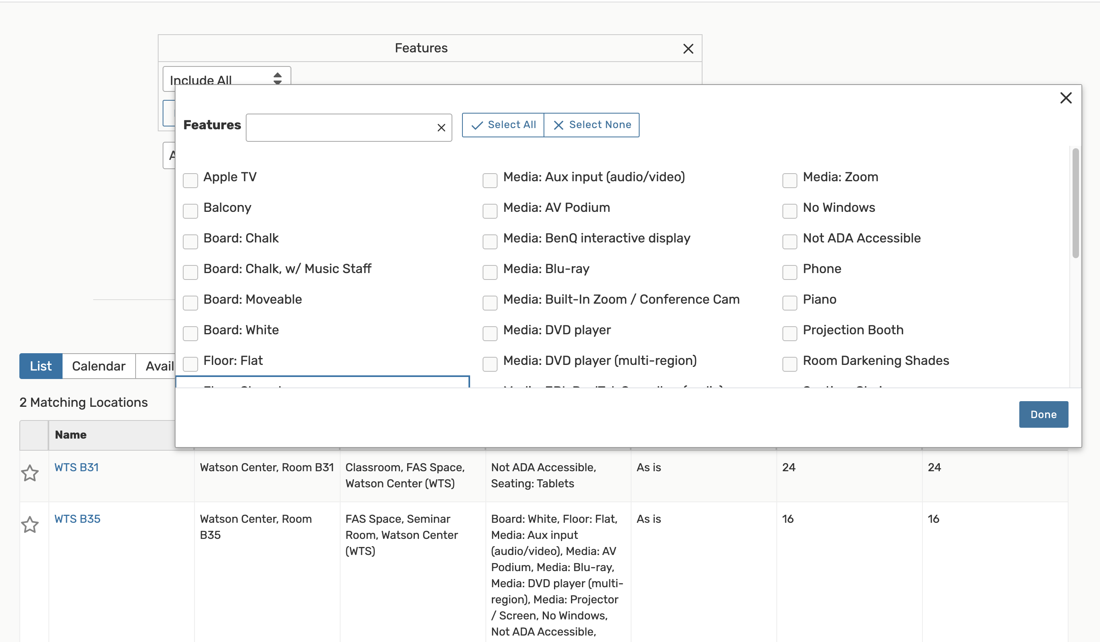
What information already exists about campus classrooms
Beyond campus map, leverage the data in 25Live
Plan to work with Registrar to group features that can be packaged for “accessibility-enhanced” spaces

Slide 7
Planned Upgrades to AV
Survey of current facilities and planned upgrades shared with support staff on both Ed Tech and Accommodations/Services sides

Slide 8
Guidance: Multi-pronged Part 1
Faculty Training
What kinds of things to look for in a room
What kinds of tech considerations to make if booking spaces
Event Guidance
In person and virtual
What kinds of things to look for in a room
What kinds of tech considerations to make when booking spaces

Slide 9
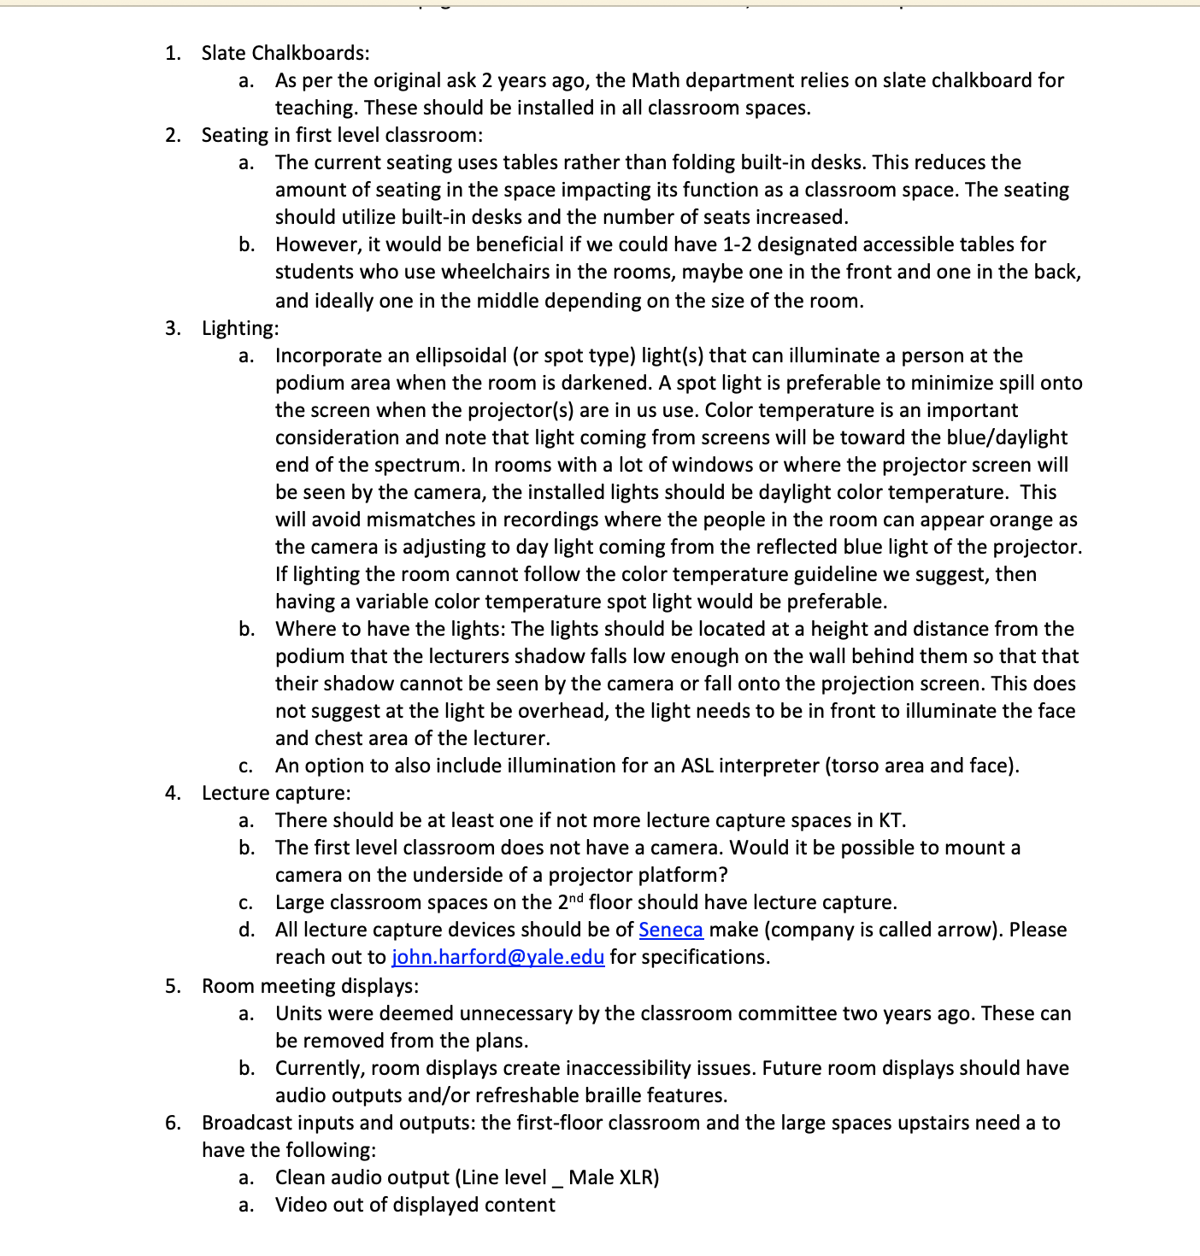
Guidance: Multi-pronged Part 2
Building standards by project: Case Study: Math building
Lighting for ASL interpreters
Increase collaboration with Broadcasting staff
Incorporating faculty into page turn review at all stages
Digital Signage
Lecture Capture specs
Etc.

Slide 10
Next steps:
Writing THE guidance– Need to communicate tech requirements and put into play at funding stage
Increasing A/V support and knowledge (current ratio is 1:40 at Yale for techs to rooms)
Classroom support but also other crucial student experiences– TV rooms, Dining Halls, Residential Colleges (lounges, gyms, theaters), Worship spaces, GLAMS, etc.

Slide 11
Discussion?
Does your college or university have a similar committee?
What kinds of guidance have you developed and how are you communicating it?
Is there a minimum threshold of classrooms to bake these standards into? What is it? How to determine that number?

Slide 12
Thank You

